Slide 1
Python Functions: Building Blocks of Code

Slide 2
Introduction to Python Functions
Definition: Reusable blocks of code that perform specific tasks
- Key benefits:
1. Code organization and modularity
2. Reusability and maintainability
3. Abstraction of complex operations
4. Facilitates teamwork and collaboration

Slide 3
Why Functions Matter in Software Development
Description
- Increased productivity through code reuse
- Improved code readability and maintainability
- Easier debugging and testing
- Supports agile development methodologies
- Enables creation of libraries and frameworks
- Facilitates scalable software architecture.

Slide 4
Function Definition Best Practices
Description
1. Use descriptive names (verb_noun convention)
- Good: `calculate_total_revenue()`
- Avoid: `cr()`
2. Keep functions small and focused (Single Responsibility Principle)
- Aim for 20-30 lines of code per function
- Each function should do one thing well
3. Use clear and concise docstrings
- Explain purpose, parameters, return value, and any exceptions
4. Follow consistent indentation and styling (PEP 8)

Slide 5
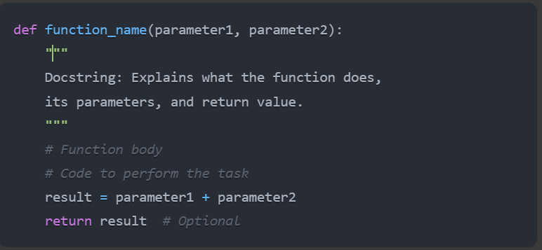
Anatomy of a Python Function :Definition
def: Keyword to define a function
function_name: Descriptive name for the function
parameters: Input values the function expects
docstring: Documentation for the function
return: Statement to send result back to caller

Slide 6
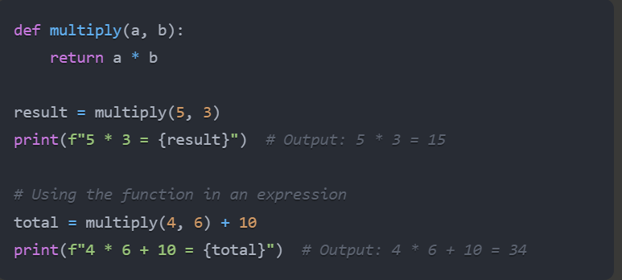
Calling Functions
Description:
- Basic syntax: `function_name(argument1, argument2)`
- Functions are called by using their name followed by parentheses
- Arguments are passed inside the parentheses
The function call can be part of a larger expression
Example:

Slide 7
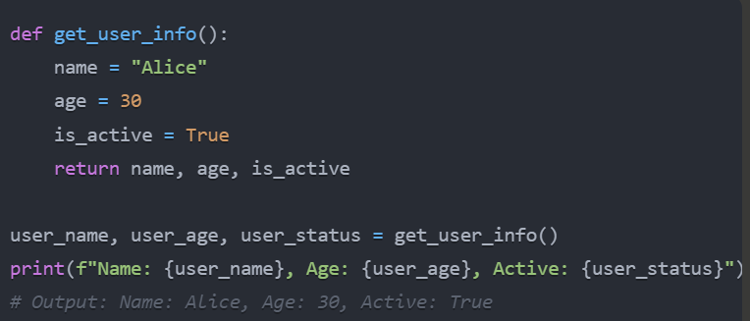
Return Statements in Detail
Description : Example:
`return` sends a result back to the caller
Functions can return:
Single values: `return 42`
Multiple values: `return x, y, z`
Complex data structures: `return {"name": "John", "age": 30}`
Without `return`, functions implicitly return `None`
`return` immediately exits the function

Slide 8
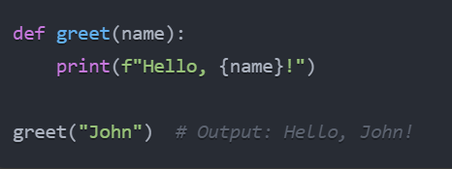
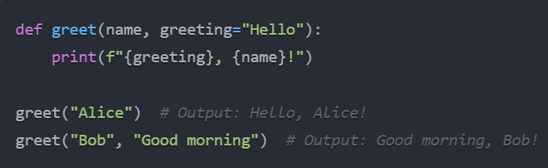
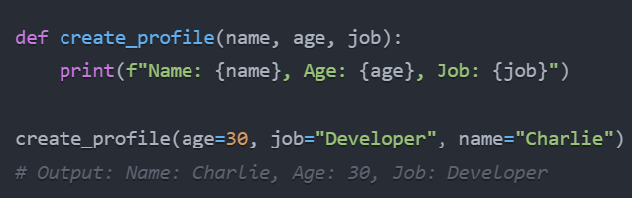
Parameters and Arguments
1. Required parameters
2.Default parameters
Must be provided when calling the function python
Have a predefined value if not specified python
3. Keyword arguments
Specified by parameter name

Slide 9
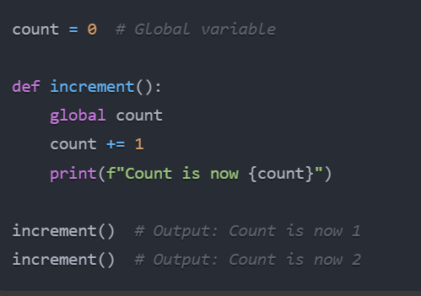
Variable Scope
Description: Example:
1. Local scope
- Variables defined inside a function
- Accessible only within the function
2. Global scope
- Variables defined outside of functions
- Accessible throughout the entire program
3. The `global` keyword
- Allows modification of global variables within a function

Slide 10
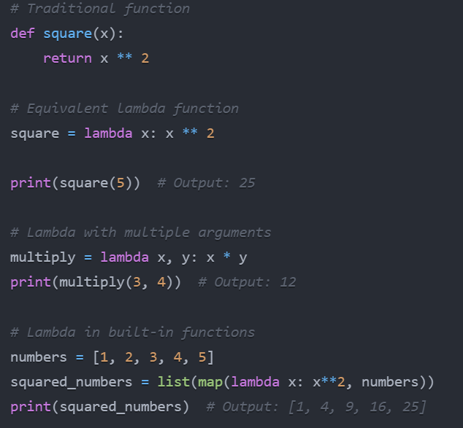
Lambda Functions
Description: Example:
Small, anonymous functions
- Can have multiple arguments but only one expression
- Useful for short, simple operations
Syntax: `lambda arguments: expression`

Slide 11
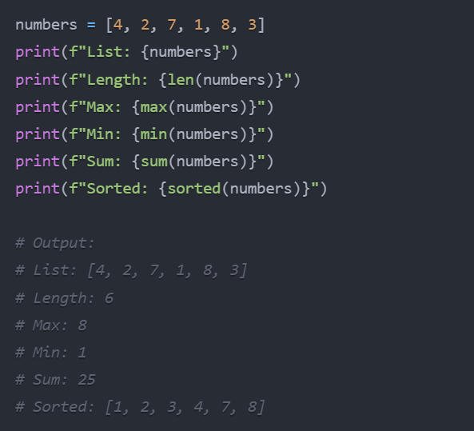
Built-in Functions
Description: Example:
Python provides many useful built-in functions:
1. `print()`: Output text to the console
2. `len()`: Return the length of an object
3. `range()`: Generate a sequence of numbers
4. `type()`: Return the type of an object
5. `int()`, `float()`, `str()`: Type conversion
6. `max()`, `min()`: Find maximum and minimum values
7. `sum()`: Calculate the sum of a sequence
8. `sorted()`: Return a new sorted list
9. `enumerate()`: Return an enumerate object
10. `zip()`: Combine multiple iterables
11.map(): Applies a given function to each item in an iterable and
returns an iterator of results.
12.filter(): Creates an iterator from elements of an iterable for which a given function returns True.

Slide 12
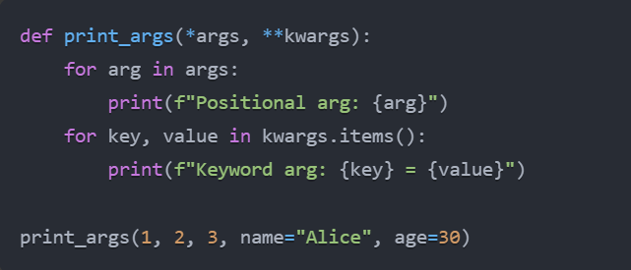
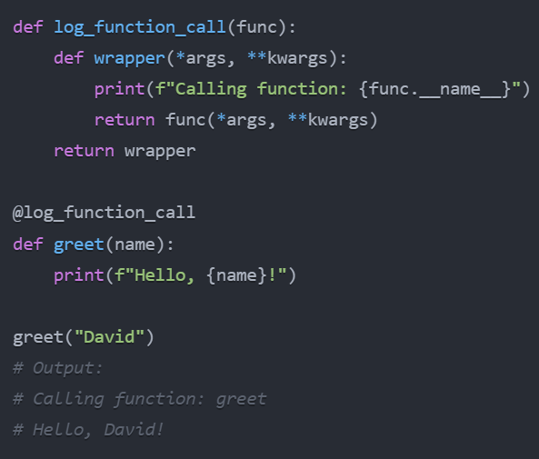
Advanced Function Concepts
1. *args and **kwargs 2. Decorators
- `*args`: Accept any number of positional arguments
- `**kwargs`: Accept any number of keyword arguments
- Modify or enhance functions without changing their code
- Commonly used for logging, timing, authentication, etc.

Slide 13
Function Best Practices
1. Follow the DRY principle (Don't Repeat Yourself)
- Avoid code duplication by creating functions for repeated tasks
2. SOLID principles
- Single Responsibility: Each function should have one job
- Open-Closed: Open for extension, closed for modification
3. Write clear documentation and comments
- Use docstrings to explain function purpose, parameters, and return values
4. Implement proper error handling
- Use try-except blocks to handle potential errors gracefully
5. Write unit tests for functions
- Ensure reliability and ease of maintenance
6. Consider performance implications
- Be mindful of function calls in loops or recursive functions

Slide 14
Conclusion
- Functions are fundamental building blocks in Python programming
- They promote code organization, reusability, and maintainability
- Proper use of functions leads to more efficient and scalable software
- Mastering functions is crucial for effective corporate software development

Slide 15
Q & A

